Slide 1

DEVELOPMENT OF A LOW-COST POTENTIOMETER
USING
ARDUINO TECHNOLOGY
Supervisor : Dr.Chinthaka Nadun Ratnaweera
B.K.R.I.Wanshanatha(SC/2020/11523) R.M.P.M.Rajapaksha(SC/2020/11577)
1

Slide 2
OUTLINE
Introduction
Problem Statement
Objectives
Methodology
Circuit Design
Calibration Process
Results Validation
Discussion
Conclusion
2

Slide 3
INTRODUCTION
Key Challenge
Traditional potentiometers:
Growing demand for affordable scientific tools.
Importance of hands-on learning in scientific education.
Potentiometry’s role in analytical chemistry.
3

Slide 4
PROBLEM STATEMENT
Research Question
How can a low-cost Arduino-based potentiometer:
Increase efficiency,
Reduce costs, and
Enhance educational capabilities in physical chemistry labs?
4

Slide 5
OBJECTIVES
Develop a Low-Cost Potentiometer
Create an affordable alternative to conventional lab equipment.
Enable Wireless Data Transmission
Use Bluetooth for real-time data sharing.
Enhance Student Learning Experience
Enable hands-on interaction with advanced measurement techniques.
Improve Laboratory Efficiency
Simplify data collection and analysis.
5

Slide 6
METHODOLOGY
Materials
Arduino Uno board
HM-10 Bluetooth module
AD620 Instrumental Amplifier
Voltage sensor
LCD Display
Electrodes (Hg/HgCl, Platinum)
E = E - E
Cell
Cathode
Anode
Key Development Steps
Design the electronic circuit.
Calibrate voltage sensor and amplifier.
Implement Arduino source code.
Develop the Android application
6

Slide 7
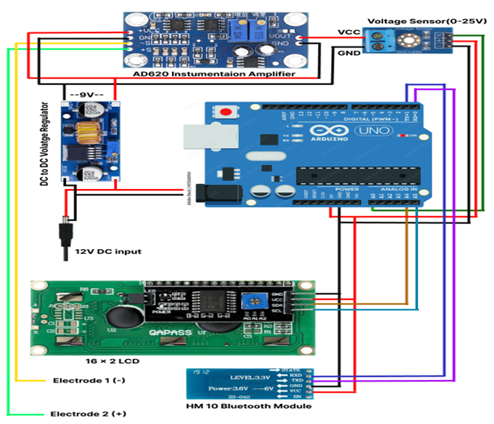
CIRCUIT DESIGN
Key Components:
Voltage Sensor for capturing voltage levels.
AD620 Amplifier processes signals.
Arduino reads and displays values.
Bluetooth module for wireless transmission.
7

Slide 8
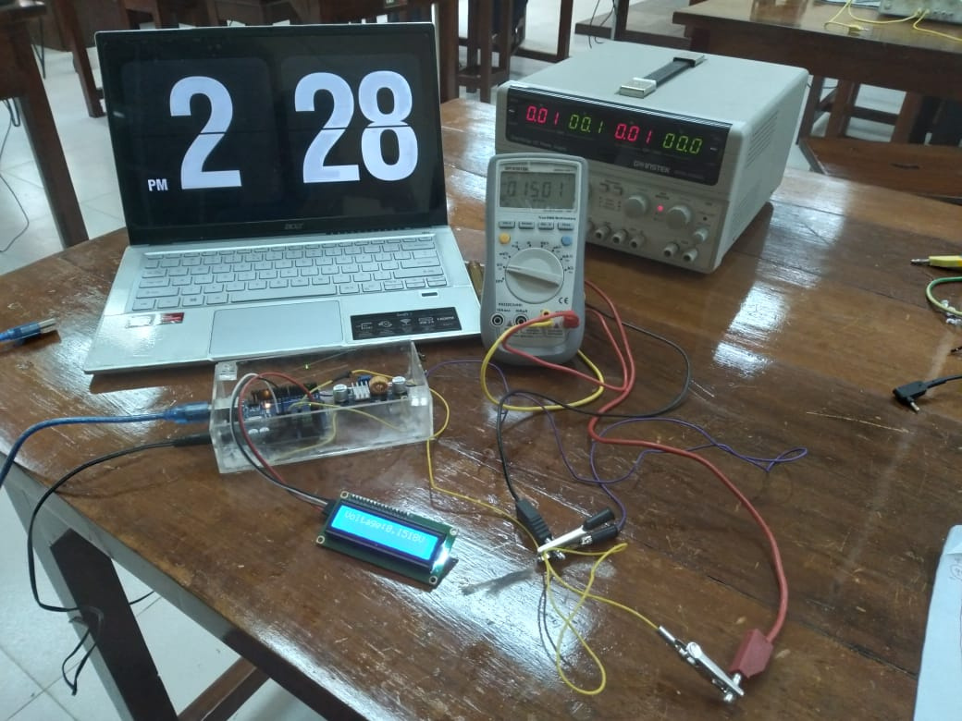
CALIBRATION PROCESS
Voltage Sensor Calibration
For voltage sensor
Voltage=(AnalogRead∗0.0234)−0.3486
For AD620
OutVoltage=(InVoltage∗22.541)−0.0144
8

Slide 9

DEVELOPED ANDROID APPLICATION
9

Slide 10
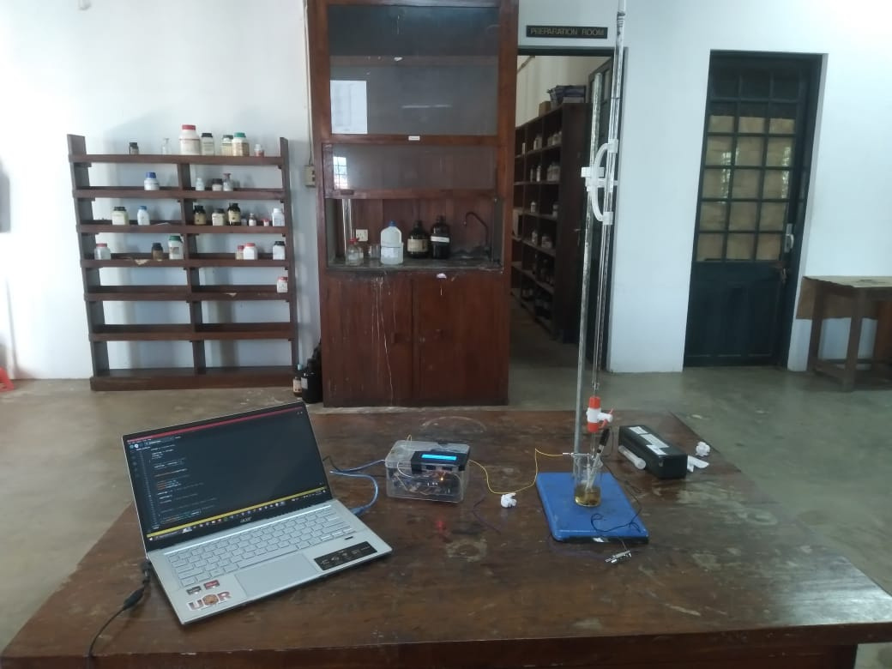
TESTING TIME OF THE INSTRUMENT
11

Slide 11
RESULTS VALIDATION
Results Validation
Comparative Analysis:
Objective: Validate Arduino-based potentiometer’s accuracy compared to laboratory potentiometer.
Data: EMF values measured with NaOH volumes.
Observations:
High consistency with 4 decimal place accuracy.
Strong correlation with standard laboratory instruments.
Minimal reading variation, ensuring reliability.
10

Slide 12
DISCUSSION
Challenges Addressed
Managed initial fluctuations in readings.
Handled connection-related variations.
Improved accuracy and precision.
Key Innovations
Averaged 50 readings for stability.
Android app with real-time graphing.
Wireless data transmission via Bluetooth.
12

Slide 13
CONCLUSION
Project Achievements
Developed a cost-effective potentiometer.
Accuracy comparable to laboratory instruments.
Reduced equipment costs.
Enhanced student learning experiences.
Future Potential
Adaptable for various lab settings.
Potential for further technological enhancements.
A model for affordable scientific instrumentation.
13

Slide 14
THANK YOU
14

